Slide 1
Learning long-distance dependencies via hierarchical distributional information: Expectation Maximization and Finite-state Tree automata
Yang Wang
2021 Psycho/CompLing seminar

Slide 2
Roadmap
Motivations & Background
The Learner
The model: probabilistic finite-state tree automata
Learning algorithm: expectation-maximization
Simulations over toy datasets (wh-movements)
C-commanding relations can be learnt via distributional information with a restricted hypothesis space,
which aligns with the claims highlighted by many works (e.g. Lari and Young 1990; Jarosz 2006).

Slide 3
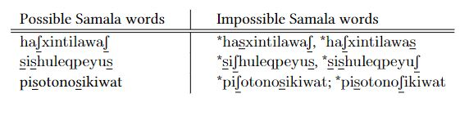
Motivations
Languages exhibit non-local dependencies across different modules.
In phonology: vowel/consonantal harmony/disharmony
Sibilant harmony in Samala (Applegate 1972; further Heinz 2016)
At a morpheme level:
Non-adjacent dependencies with intervening morphemes (Santelmann & Jusczyk 1998; Gomez & Maye 2005)
is running *can running
is quickly running *can quickly running
In syntax, long distance dependencies:
Wh-movement (Perkins & Lidz 2021)
a. The chef burned (*entirely) the pizza.
b. What did the chef burn _____?
c. *What did the chef burn the pizza?

Slide 4
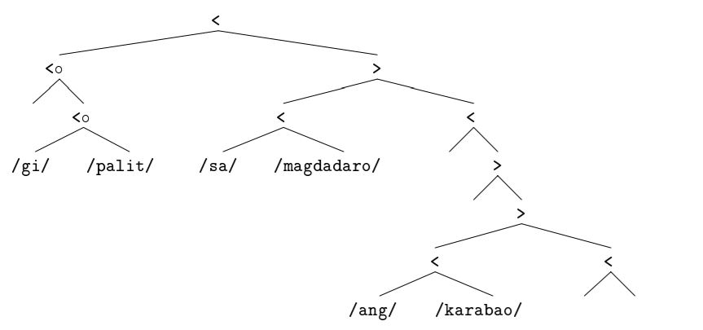
Motivations
How can a learner learn it?
The learnability of grammar with movements
Stabler (1998): MGs encoding move operations
MGs characterizing the set of strings is not identifiable in the limit of positive text only under Gold’s paradigm.
Solutions:
“One strategy for making a learning problem easier is to enrich the evidence.”

Slide 5
Motivations
How can a learner learn it?
Recent empirical investigations seem to favor the enriched input account of movement learning, and suggest an incremental learning mechanism by using prior syntactic knowledge. (e.g. Perkins 2019)
the developmental stage of verb transitivity occurs before differentiating sentence types.
- Gap-driven Learning Hypothesis (e.g. Perkins 2019)
A learner might be using predicate-argument structure to identity types of movement dependencies.
i. detect argument gaps by the knowledge of verb argument structure
ii. identity what forms are correlated with postulated gaps
iii. Infer the underlying dependencies
Results from computational modeling works (e.g. Perkins et al 2019) support the feasibility of this hypothesis.
The question pertains: what underlying syntactic dependencies and how to track them?

Slide 6
Main question
Whether it’s in principle possible to learn structural relations of such non-local dependencies by distributional information?
Computational task: maximum likelihood parameter estimation in a Probabilistic Finite-State Tree grammar.
If we give the learner enriched hierarchical inputs, which cover predicate-argument structure and non-local wh words,
- Whether the distributional information is robust enough to learn the grammar that captures expected structural restrictions.
- Whether it’s only learning the expected grammars?

Slide 7
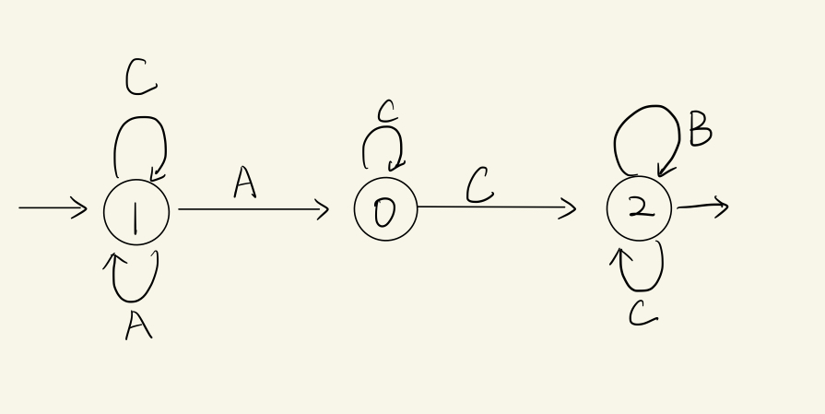
The model: Probabilistic Finite-State Tree Automaton
Finite-state tree automata are extensions to finite-state machines that work on trees!
C A C B
1
1
0
2
2
In a surface string, the unobserved hidden structure is the state information.
A transition: state × symbol × state
(1, “A”, 0)
A transition in Finite-state tree automaton: state × symbol × [state]
(1, “A”, [0, 1])

Slide 8
The model: Probabilistic Finite-State Tree Automaton
Finite-state tree automata are extensions to finite-state machines that work on trees!
An example: three possible states
Wh: “I am a wh word”
Obj: “ I need some objects”
Neutral
The root of a tree can only be in Neutral state encoding resolved dependencies.
I(Neutral) = 1.0, I(Obj) = 0.0, I(Wh) = 0.0
Possible transitions:
(Neutral, “*”, [Wh, Obj])
(Obj, “*”, [Neutral, Obj])
(Wh, “what”, [])
C
A
C
B
In a surface tree, the unobserved hidden structure is still the state information.

Slide 9
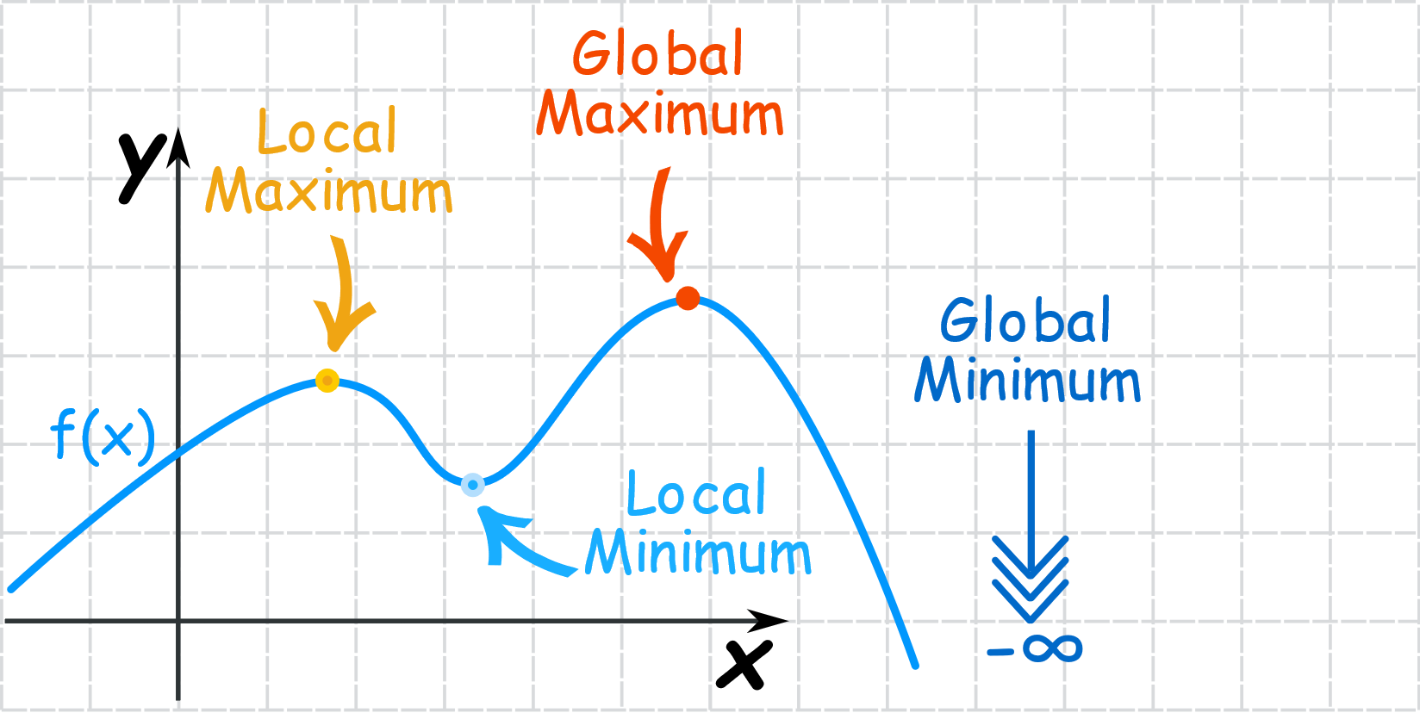
The learning algorithm: Expectation-Maximization
Expectation-Maximization (Dempster et al 1977) is THE algorithm used to learn hidden structures.
Probabilistic context-free grammars (Charniak 1993; Goldwater & Johnson 2005…) ➔ Inside-Outside Algorithm
Probabilistic finite-state machines (Elsner et al 2013; Cotterell et al 2015…) ➔ Forward-Backward Algorithm
Variations of OTs to learn underlying forms, metrical structures…. (Jarosz 2006, 2015; Pater et al 2012; Nelson 2019…)
Why EM? :
Divided a relatively difficult optimization problem into a series of easier subproblems.
Guarantee to improve the likelihood each iteration.
BUT! It might get stuck in local optima.
“The initialization of the parameters is an important factor in determining how good the final grammar is.”
(Lari & Young 1990; quotes from in Jarosz 2006) ➔ Random-start hill climbing

Slide 10

Expectation-Maximization: The general mechanism
Initialize the parameters
Expectation-step: Calculate the expected complete dataset from the incomplete dataset
In PFSA that reads strings,
0
0
C A C B
1
1
2
2
P(q = 0)
= P1(suffix = “ACB” and reach a final state from this state)*
P2(prefix = “C” from a legal initial state to this state)
P1 = the summed probability of all paths from 0 to a final state that emits ACB
P2 = the summed probability of all paths to 0 from an initial state that emits C
Maximization-step: get better parameter values by maximizing the likelihood of “filled-in” corpora.
Relative frequency would suffice our purposes.

Slide 11






Expectation-Maximization
Wh; Obj; Neutral
*
Then, in terms of trees……
Wh; Obj; Neutral
Wh: “I am a wh word”
Obj: “ I need some objects”
Neutral
What
*
Wh; Obj; Neutral
q
do
*
Wh; Obj; Neutral
Expectation-step: calculate the expected complete corpora
you
*
Wh; Obj; Neutral
What’s the probability that q is Obj:
= P1(can generate the green subtree from this state)*
P2(can have the tree context from a legal initial state to this state)
t
want
Maximization-step: Relative frequency

Slide 12
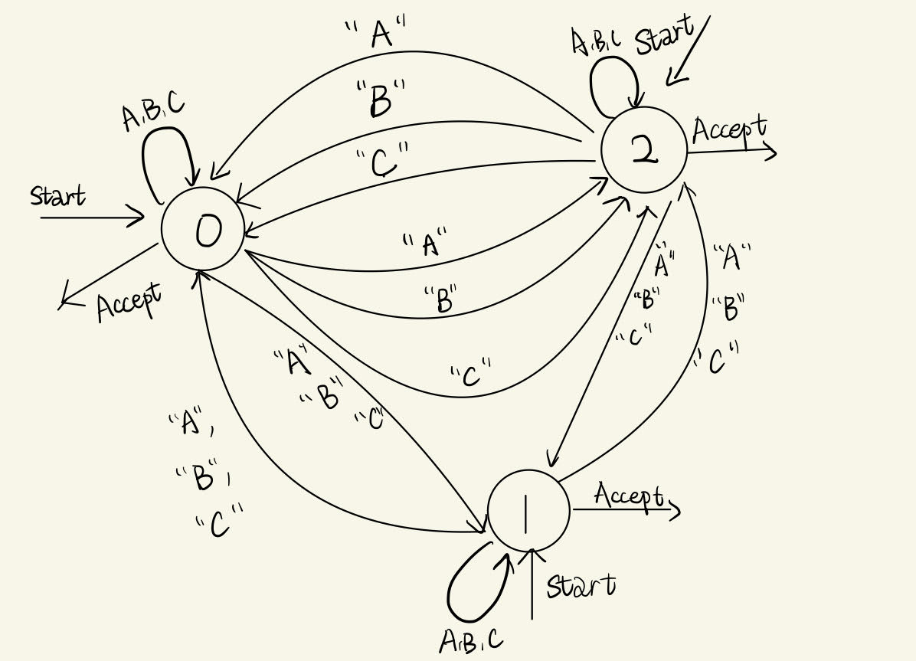
Expectation-Maximization
Assume a language X has a long-distance co-occurrence restriction that when you see a B must have an A segment preceding it.

Slide 13
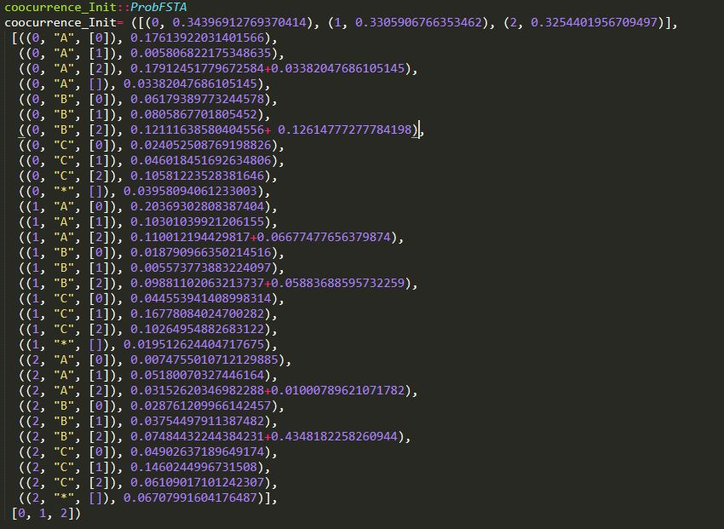
Expectation-Maximization
C A C C B C
C C C C C C
C A C B C
C A C C C B C
C A C C C B C
C A C C C C B C
A A C C C C B
1 1.0
1,"C“, [1] 0.4376145053159298
1,"A", [0] 0.4105681513045988
1,"C",[0] 0.08.22
1,"A", [1] 0.0695
======================================
0,"C",[0] 0.4974052335455888
0,"C",[2] 0.49001501159141314
=======================================
2,"B",[2] 0.2447953716584791
2,"C",[2] 0.46960926288176436
2,"*",[] 0.2855950122944346
====================p<0.05==============
0,"A",[0] 1.2579754862998076e-2

Slide 14
Toy datasets + Simulation Results
Tree-set: 20 randomly generated binary branching trees
try to mimic the distributions of dislocated wh-words and the predicate-argument structure
Shared characteristics
- Have “*”s as the non-terminals, As, Bs and Cs as the leaves
- A c-commands B (in hope to get A: wh-word; B: gaps/verbs with missing object)
- Only one A and one B
- 16 trees have “A” as the topmost leaf and 4 trees have “C” c-commanding “A”
*
A
*
C
B

Slide 15
Simulation 1: Unrestricted hypothesis space
The assumption is the learner already knows the final grammar has 3 states and the input trees are all binary branching.
No further restriction added to the parameters; Then we have
- Number of parameters for the root node (initial state): |Q| = 3
- Number of transitions for the branching (transitions): |Q|*|∑|*(|Q|^k+1) = 3*4*10 =120
Randomly initialized 10 pfstas and pick the final grammar which yields the best fit among these 10.
I(0) = 1.0
R(0,"*",[1,1]) = 0.8333333322117928
R(0,"*",[2,0]) = 0.16666666530377267
================================
R(1,"*",[2,2]) = 0.4834487131410787
R(1,"A",[]) = 0.4834486895665185
=================================
R(2,"*",[2,2]) = 0.25510545826268904
R(2,"B",[]) = 0.21591145850795904
R(2,"C",[]) = 0.5289830733444996
0
*
1
1
A
*
2
2
C
B
Likelihood of the data: 3.4114787350292974e-174 ➔3.541446196261009e-59

Slide 16
Simulation 1: Unrestricted hypothesis space
I(0) = 1.0
R(0,"*",[1,1]) = 0.8333333322117928
R(0,"*",[2,0]) = 0.16666666530377267
================================
R(1,"*",[2,2]) = 0.4834487131410787
R(1,"A",[]) = 0.4834486895665185
=================================
R(2,"*",[2,2]) = 0.25510545826268904
R(2,"B",[]) = 0.21591145850795904
R(2,"C",[]) = 0.5289830733444996
0
*
1
1
*
*
2
2
2
2
B
B
C
C
All learners track that only “*” is the non-terminal and “A”, “B”, “C” are leaves well.
All 10 initializations fail to assign leaf nodes “A”, “B”, “C” to separate states.
➔It either assigns “B” together with “C”, or “A” together with “C”, or sometimes “A”, “B”, “C” together.
➔The initial state is always the one without lexical item assignment.
Sometimes the learner pays attention to the unnecessary ordering effects:
R(1,"*",[0,1]) = 0.4093889979944503; R(1,"*",[1,0]) = 1.922214579228846e-2
What restriction(s) do we have to make to the hypothesis space for only getting the c-commanding relation as we would hope for?

Slide 17
Simulation 2: Automatic lexical-state assignment; no need to track ordering
The assumption is the learner already knows the final grammar is 3 states and the input trees are all binary branching.
the learner wouldn’t need to figure out that which is non-terminal, which are leaves
the learner already knows that “A”, “B”, “C” correspond to different states
the learner is insensitive to ordering and would think [0, 1] is the equivalent to [1, 0]
Then we have
- Number of parameters for the root node (initial state): |Q| = 3
- Number of transitions for the branching (transitions): |Q|*[(|Q|*(|Q|-1)*..)+1] = 3*7 =21
Randomly initialized 10 pfstas and pick the final grammar which yields the best fit among these 10.
I(0) = 1.0
R(0,"*",[0,2]) = 0.45454545454545453
R(0,"A",[]) = 0.45454545454545453
R(0,"*",[0,1]) = 0.09
===============================
R(1,"*",[1,1]) = 0.1967213114754098
R(1,"C",[]) = 0.8032786885245902
===============================
R(2,"*",[1,2]) = 0.6226415094339622
R(2,"B",[]) = 0.37735849056603776
0
*
0
2
Aha, it sees that B can percolate up when meeting Cs!
A
*
1
2
Likelihood of the data: 4.887224205860086e-168 ➔ 5.586294216495976e-47
C
B

Slide 18
Simulation 2: Automatic lexical-state assignment; no need to track ordering
0
I(0) = 1.0
R(0,"*",[0,2]) = 0.45454545454545453
R(0,"A",[]) = 0.45454545454545453
R(0,"*",[0,1]) = 0.09
===============================
R(1,"*",[1,1]) = 0.1967213114754098
R(1,"C",[]) = 0.8032786885245902
===============================
R(2,"*",[1,2]) = 0.6226415094339622
R(2,"B",[]) = 0.37735849056603776
*
0
2
*
B
0
2
A
B
Among10 initializations, learnt “A” tree 5 times; “B” tree 4 times; “C” tree 1 time
➔It seems the learner is doing something when it sees “B”, but still not quite we want.
➔ A conjecture of overfitting: it picks the state governing “A” as the initial state because among 20 trees, 16 has “A” as the topmost leaf. Usually in probabilistic approaches in dealing with syntactic representations, depth really matters!

Slide 19
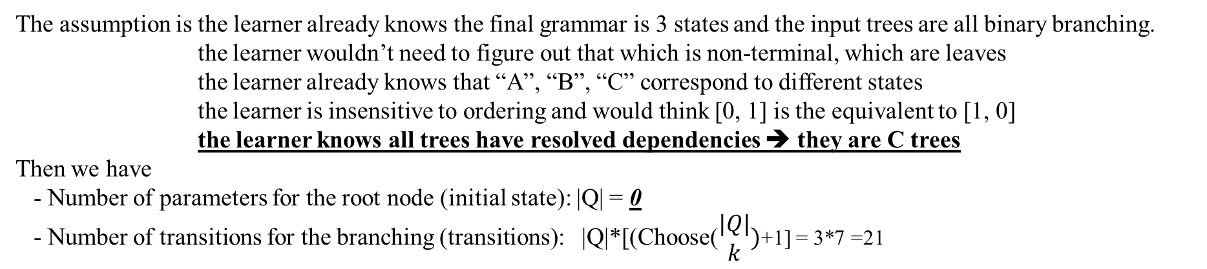
Simulation 3: Simulation 2 + Trees always has resolved dependency.
The assumption is the learner already knows the final grammar is 3 states and the input trees are all binary branching.
the learner wouldn’t need to figure out that which is non-terminal, which are leaves
the learner already knows that “A”, “B”, “C” correspond to different states
the learner is insensitive to ordering and would think [0, 1] is the equivalent to [1, 0]
the learner knows all trees have resolved dependencies ➔ they are C trees
Then we have
- Number of parameters for the root node (initial state): |Q| = 0
- Number of transitions for the branching (transitions): |Q|*[(Choose($\begin{matrix}|Q| \\ k\end{matrix})$+1] = 3*7 =21
I(2) = 1.0
========================
R(0,"A",[]) = 1.0
=========================
R(1,"*",[1,2]) = 0.6226415094339622
R(1,"B",[]) = 0.37735849056603776
===========================
R(2,"*",[0,1]) = 0.23529411764705882
R(2,"*",[2,2]) = 0.18823529411764706
R(2,"C",[]) = 0.5764705882352941
2
*
0
0
A
*
2
0
C
B
Likelihood of the data: 2.2380644020642265e-129➔7.086922962840619e-52

Slide 20
Simulation 3: Simulation 2 + Trees always has resolved dependency.
I(2) = 1.0
========================
R(0,"A",[]) = 1.0
=========================
R(1,"*",[1,2]) = 0.6226415094339622
R(1,"B",[]) = 0.37735849056603776
===========================
R(2,"*",[0,1]) = 0.23529411764705882
R(2,"*",[2,2]) = 0.18823529411764706
R(2,"C",[]) = 0.5764705882352941
This is really the grammar we want!
Among 10 initializations, this grammar is learnt as the final grammar 6 times.

Slide 21
Summary over simulations
 | Simulation 1 | Simulation 2 | Simulation 3
Restrictions | N/A | No ordering; No lexical assignment | No ordering; No lexical assignment No need to guess dependency resolved/unresolved
Best likelihood achieved | 3.541446196261009e-59 | 5.586294216495976e-47 | 7.086922962840619e-52
Might be overfitting
I also constructed two more treesets. The first contains 20 trees similar to the presented treeset but less type frequency. The other is 25 binary branching trees , the productions of which are sampled from Bates-WH CHILDES treebank.
Simulation results on these two treebanks show the same statistical generations over different restriction.

Slide 22
Conclusions & Discussions
Whether it’s in principle possible to learn structural relations of such non-local dependencies by distributional information?
Yes! It’s possible, under restricted hypothesis space illustrating some prior syntactic knowledge.
➔ Initialization matters, which aligns with the observations from prior works that try to apply EM to language data.

Slide 23
Conclusions & Discussions
But, how much of this do look like children acquiring wh-dependencies?
I personally think that this model could resemble the next stage of acquiring long-distance dependencies after the learner differentiate different (non-basic) clause types.
They know they are complete sentences but non-basic➔ legitimacy of special lexical items, “A” and “B” and the initial state assignment
This works under the assumption that the learners would have access to the complete tree-structured syntactic information.
One question would be whether it’s realistic to have a built-up parse tree for each sentence as the inputs of learning.
If so, the gap from morpho-syntactic features in Perkins (2019) to such parse tree seems to be a non-trivial question/task and could serve as another potential developmental stage.

Slide 24
Thank you!

Slide 25
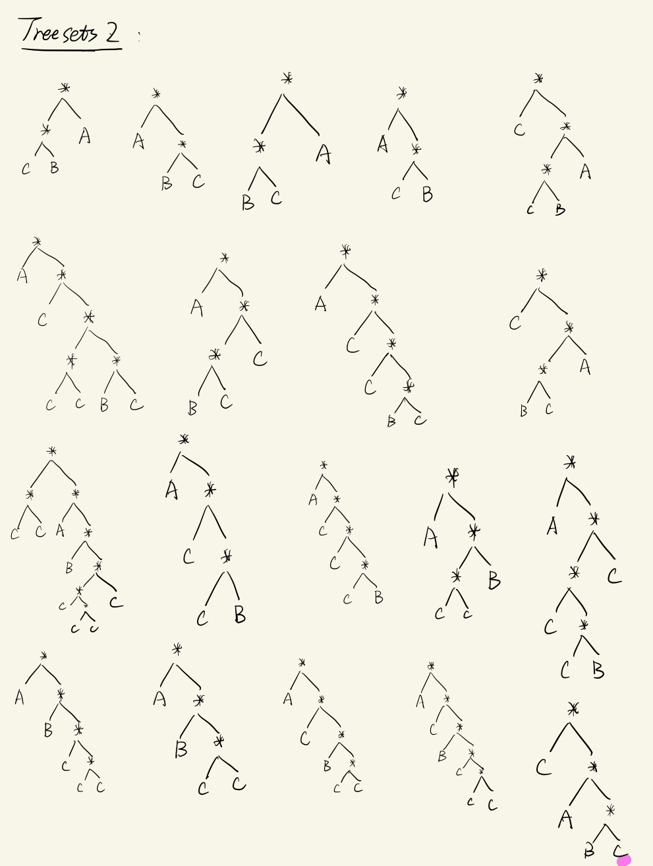
Appendix: treesets 1

Slide 26
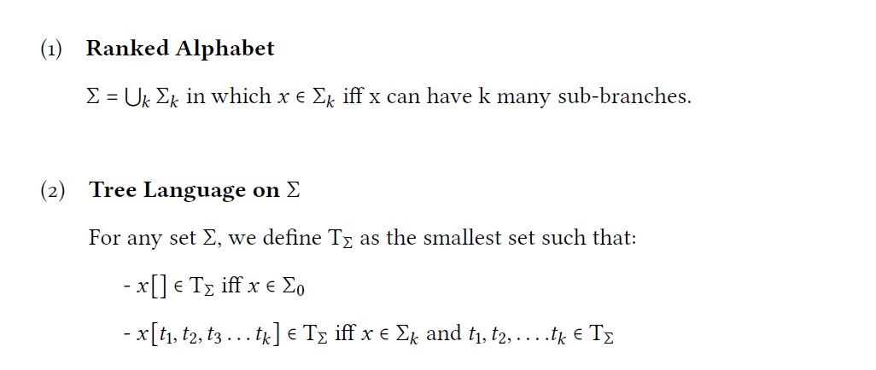
Appendix: definitions

Slide 27
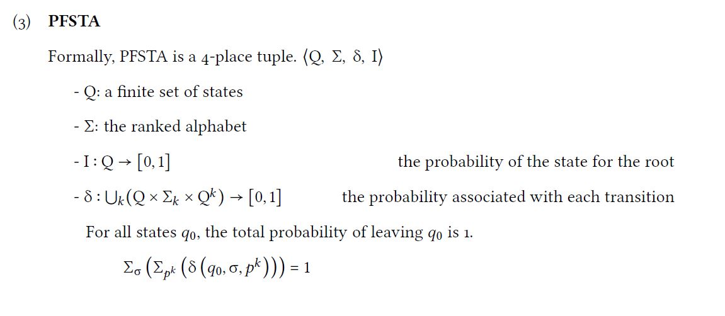
Appendix: definitions

Slide 28
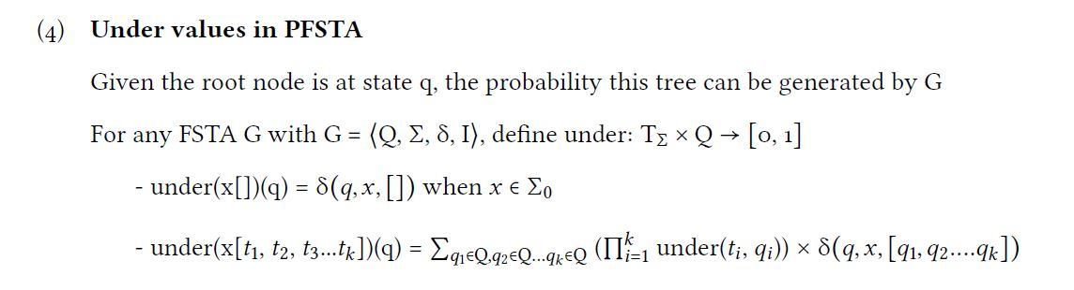
Appendix: definitions

Slide 29
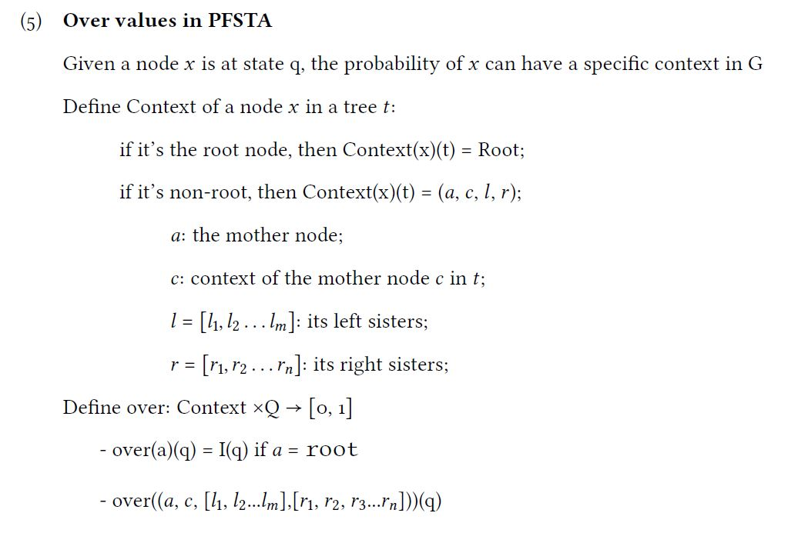
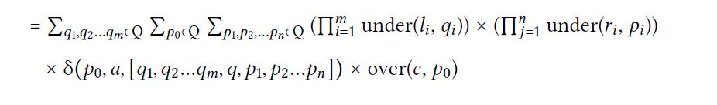
Appendix: definitions

Slide 30
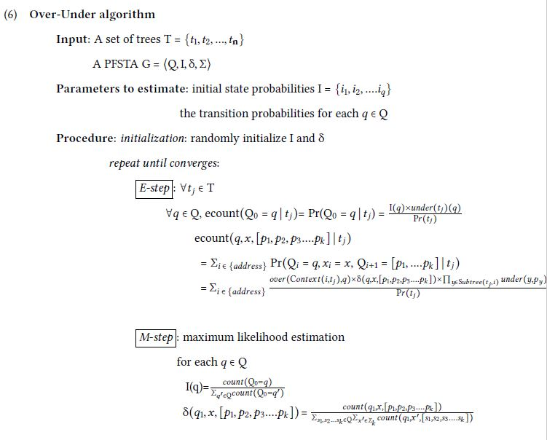
Appendix: definitions

